Slide 1
Exponential family of distributions:
https://en.wikipedia.org/wiki/Exponential_family
Generalized Linear Models
Generalized linear models are fit using the glm( ) function. The form of the glm function is
glm(formula, family=familytype(link=linkfunction), data=)
Family | Default Link Function
binomial | (link = "logit")
gaussian | (link = "identity")
Gamma | (link = "inverse")
inverse.gaussian | (link = "1/mu^2")
poisson | (link = "log")
quasi | (link = "identity", variance = "constant")
quasibinomial | (link = "logit")
quasipoisson | (link = "log")

Slide 2
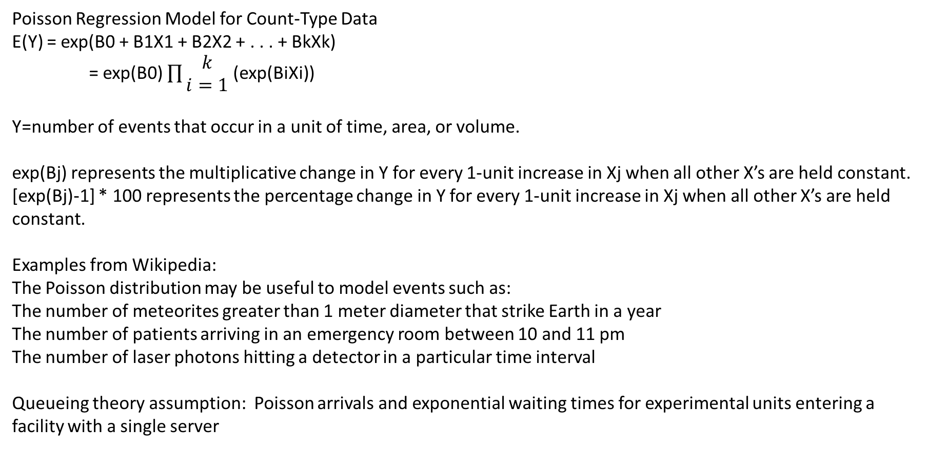
Poisson Regression Model for Count-Type Data
E(Y) = exp(B0 + B1X1 + B2X2 + . . . + BkXk)
= exp(B0) $\prod{\begin{aligned}k \\ i=1\end{aligned}}$ (exp(BiXi))
Y=number of events that occur in a unit of time, area, or volume.
exp(Bj) represents the multiplicative change in Y for every 1-unit increase in Xj when all other X’s are held constant.
[exp(Bj)-1] * 100 represents the percentage change in Y for every 1-unit increase in Xj when all other X’s are held constant.
Examples from Wikipedia:
The Poisson distribution may be useful to model events such as:
The number of meteorites greater than 1 meter diameter that strike Earth in a year
The number of patients arriving in an emergency room between 10 and 11 pm
The number of laser photons hitting a detector in a particular time interval
Queueing theory assumption: Poisson arrivals and exponential waiting times for experimental units entering a facility with a single server

